Slide 1
Secure Data Hiding in Image Using Steganography
CAPSTONE PROJECT
Presented By:
Student Name : ANANYA B SHETTY
College Name : K.S. School of Engineering and Management
Department: Electronics and Communication Engineering

Slide 2
OUTLINE
Problem Statement
Technology used
Wow factor
End users
Result
Conclusion
Git-hub Link

Slide 3
Problem Statement
With the increasing need for secure communication, traditional encryption methods can sometimes attract unwanted attention. Steganography offers a way to hide information within images, making it less detectable by attackers. This project focuses on secure data hiding in images using steganography, where secret messages are embedded into an image at the pixel level and can only be retrieved using a correct passcode. The goal is to ensure confidentiality and security in digital communication while maintaining the visual integrity of the image.

Slide 4
Technology used
Programming Language: Python 3
Libraries Used:
OpenCV (cv2): For image processing and manipulation
OS Module: For file handling and system operations
String Module: For character encoding
Platform: Windows (can be adapted for Linux/Mac)

Slide 5
Wow factors
Pixel-Level Data Hiding – The message is embedded at the pixel level, making it difficult to detect without the correct method.
Password-Protected Decryption – Only users with the correct passcode can retrieve the hidden message, adding an extra layer of security.
No Significant Image Distortion – The image appears unchanged to the human eye, ensuring stealthy communication.
Lightweight & Efficient – The code is simple, fast, and does not require complex encryption algorithms, making it easy to implement and modify.
Customizable & Expandable – The technique can be improved by adding more encryption layers or modifying the pixel encoding strategy for enhanced security.
This makes the project a practical and efficient approach to secure message transmission using steganography.

Slide 6
End users
Cybersecurity Professionals – Can use this technique for secure data transmission and research in data hiding methods.
Government and Intelligence Agencies – May utilize steganography for covert communication and confidential data exchange.
Journalists and Activists – Can use it to securely share sensitive information without detection.
Researchers and Academics – Useful for studying and improving steganographic techniques in digital security.
General Users Concerned About Privacy – Individuals who want to protect their messages from unauthorized access.

Slide 7
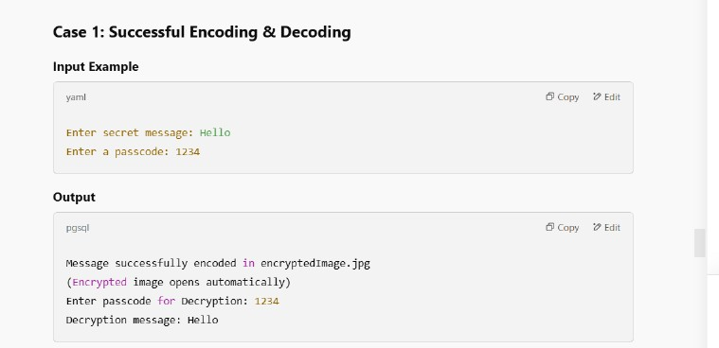
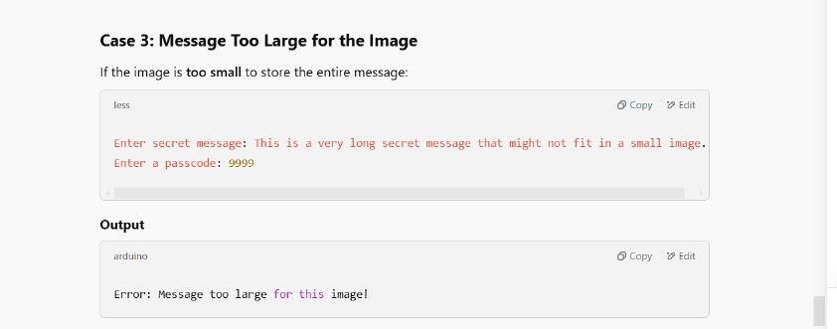
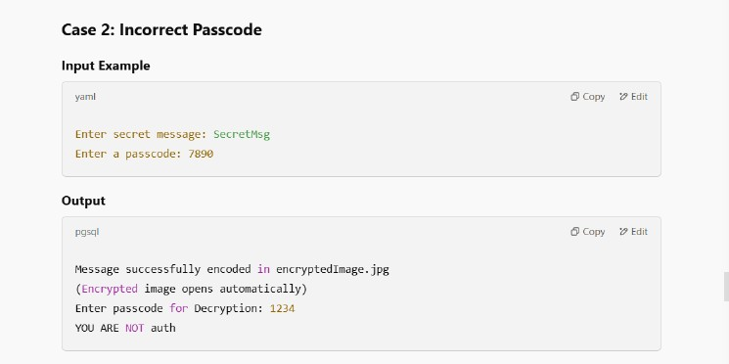
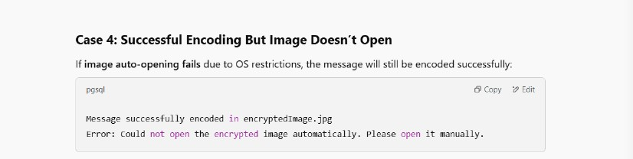
Results

Slide 8
Conclusion
This project successfully demonstrates secure data hiding in images using steganography. By embedding messages at the pixel level and protecting decryption with a password, it ensures confidentiality and security in digital communication. The method is lightweight, efficient, and does not significantly alter the image, making it a practical solution for covert data transmission.
Steganography provides an additional layer of security beyond traditional encryption, making it useful for applications where secrecy is crucial. Future improvements can enhance the encryption process and make detection even more challenging.

Slide 9
GitHub Link
MY GITHUB LINK:
https://github.com/ananyabshetty/AICTE-Cybersecurity-Project

Slide 10
THANK YOU

